Slide 1



Assessment of database construction and reduction methods in metaproteomics
department biomolecular medicine
research group Compomics
Defense Master’s Dissertation / Wout Cattrijsse / 24.06.2024
Notes:
Good afternoon everyone, I am Wout and as you all know I am here today to present to you my master’s dissertation. I will start by first giving a quick introduction into the subject matter and defining the aim of this research, followed by a summary of the used materials and methods after which I will present to you the obtained results and finish off with the overall conclusion.

Slide 2
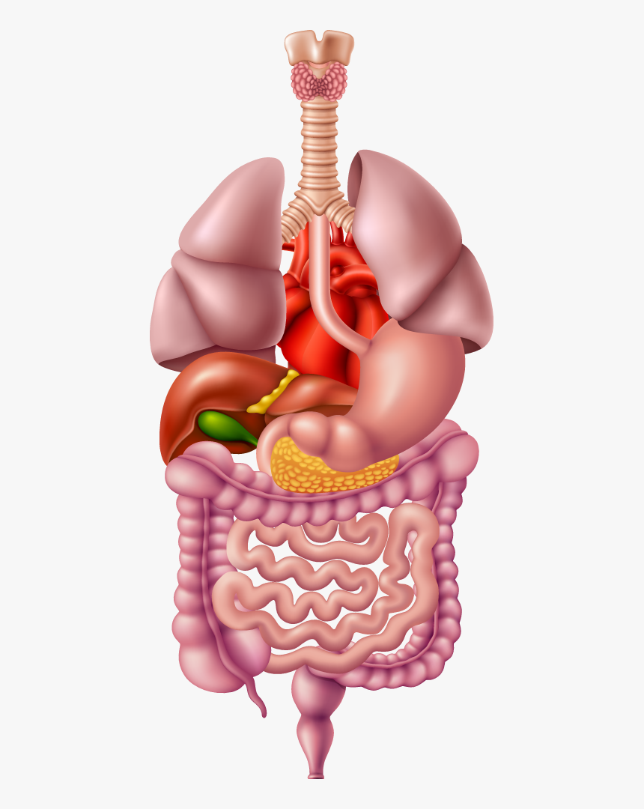
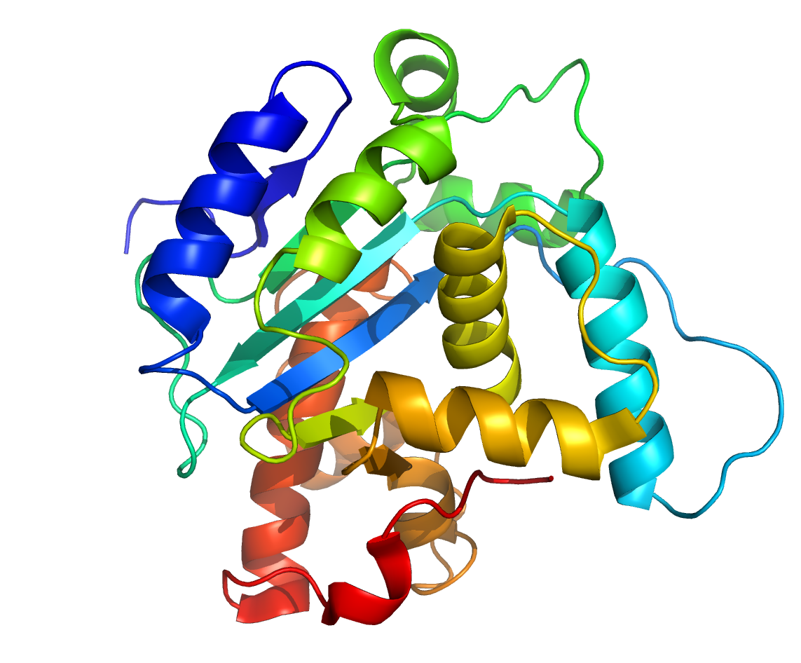
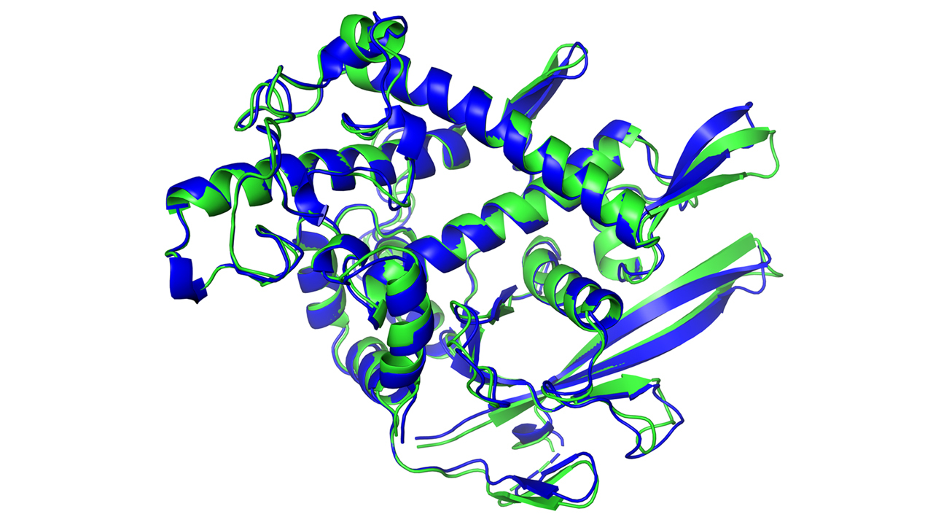


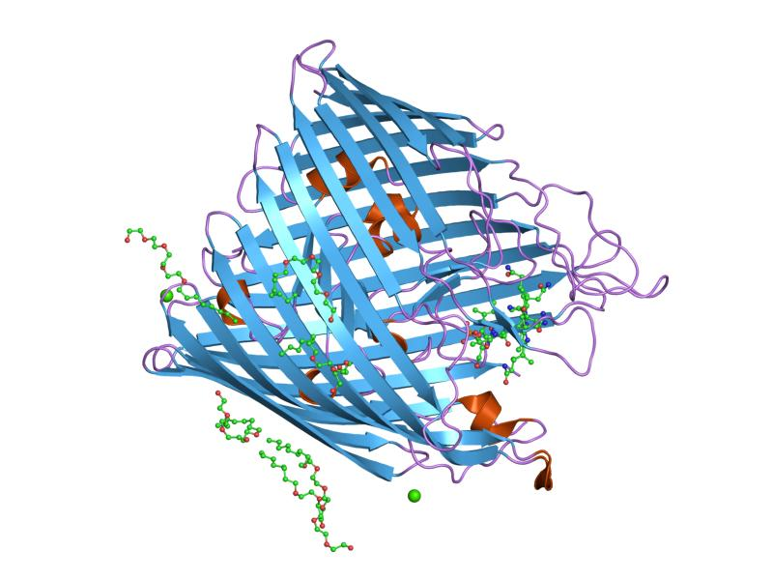




Metaproteomics aims to understand the functional activities of microbial communities
Microbial community
Applications
Human health
Gut microbiome
Full protein complement
Ocean & soil microbiome
Environmental science & agriculture
Notes:
Metaproteomics is the study of proteins, and thus the functional aspects, of microbial communities. These can be found in many places such as the human gut, the ocean or soil and the field therefore has many applications in fields such as human health, environmental science and the agricultural sector.

Slide 3
To obtain reliable results the target-decoy assumptions must be fulfilled
Decoy PSMs are a good approximation of incorrect target PSMs and their distributions are thus (very close to) equal.
An incorrect PSM is equally likely to match to a target sequence as to a decoy sequence when the database of target and decoy sequences is equal in size.
Notes:
First, we need to take a closer look at the false discovery rate estimation and how we can correctly perform this.
When performing metaproteomics experiments we use the target-decoy approach to estimate the false discovery rate. However, if we want to perform a reliable FDR estimation, we need to make sure that the target-decoy assumptions are fulfilled. These two assumptions are as follows:
I. Decoy PSMs are a good approximation of incorrect target PSMs and their distributions are thus (very close to) equal.
II. An incorrect PSM is equally likely to match to a target sequence as to a decoy sequence when the database of target and decoy sequences is equal in size.

Slide 4






There are four main methods for metaproteomic protein database generation
Matched metagenome database
Unmatched metagenome database
Restricted reference database
Unrestricted reference database
Notes:
Secondly, to effectively perform these metaproteomics studies we need to design protein sequence databases, so we can search for matches between the detected mass spectra and these protein sequences. Blakeley-Ruiz and Kleiner described the 4 main methods of metaproteomics protein database generation in a paper published in 2022. There are matched and unmatched metagenome databases which are based on metagenomic determination of the proteins present in a sample that matches the sample in question or a sample from the same ecosystem, respectively. Then there are also restricted and unrestricted reference databases whose protein sequences are derived from public repositories such as UniProtKB and they are either restricted to a certain taxonomy or they are unrestricted and thus contain all sequences from the public repository.
In an ideal scenario, this protein database contains all, and only those, proteins which are present in the sample. If a sequence is not present, it cannot be identified and could lead to false negatives or the spectrum could also be wrongfully matched against a false peptide, leading to a false positive. However, if too many sequences are present, we obtain very long search times and a decreased identification rate.

Slide 5
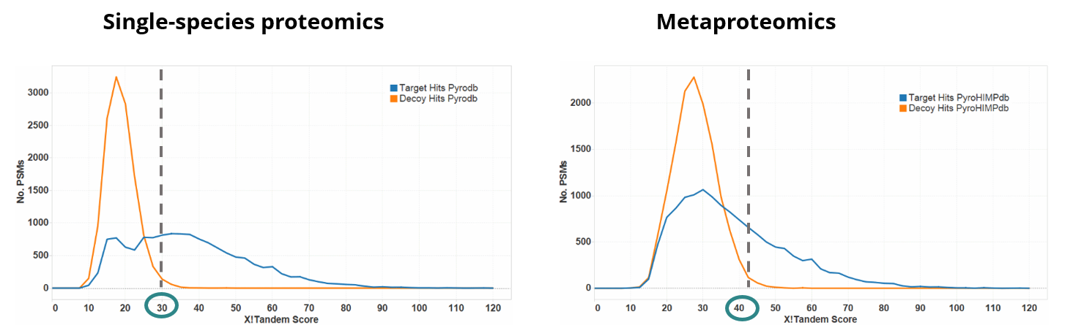
Problem: the large databases in metaproteomics cause a decrease in the identification rate
(10K proteins)
(6,1M proteins)
Notes:
Unfortunately, metaproteomic samples are characterized by their complexity because of the many different species that are present in the sample, causing a wide variety of proteins to be present in each sample. Because of this, metaproteomic protein databases are notoriously large in size leading to a decrease in the identification rate. This is illustrated in these two graphs. We see a single-species proteomics experiment on the left versus a metaproteomics experiment on the right. We can clearly see the shift in the X!Tandem cut-off score needed to obtain a 1% FDR, going from 30 in the single-species proteomics experiment to 40 in the metaproteomics experiment.

Slide 6
Problem: the large databases in metaproteomics cause a decrease in the identification rate
(10K proteins)
(6,1M proteins)
IDENTIFICATION RATE DECREASES
Notes:
This leads to a visually decreased identification rate for the metaproteomics experiment, if we maintain the same FDR threshold.

Slide 7
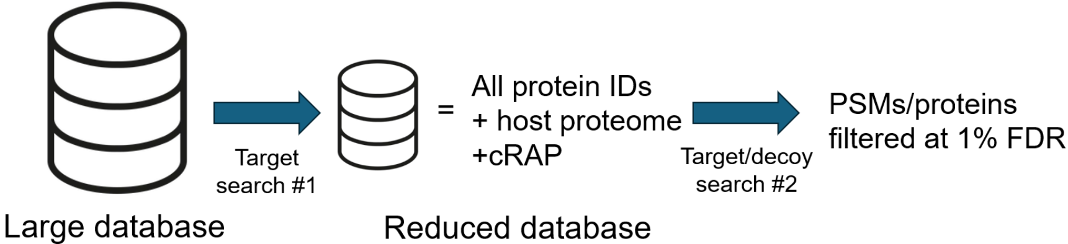
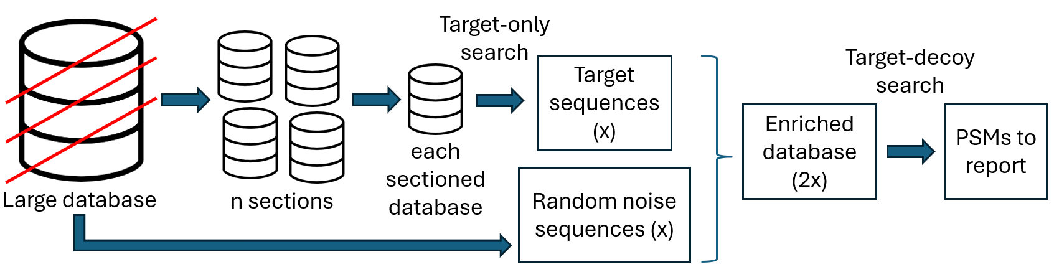
Database reduction methods are often used to increase the identification rate
Two-step method
Database sectioning method
Notes:
Since the low identification rate observed in metaproteomics can be attributed to the large databases that are used, an intuitively simple solution is to reduce the size of these databases. Two examples of such database reduction methods are the two-step search method and the database sectioning method. In the two-step method we first perform a target-only search against the large database, from this we obtain a smaller database which is concatenated with the host proteome and common contaminants. This smaller database is then used to perform a target-decoy search where the PSMs are filtered at 1% FDR. For the database sectioning method we first divide the large database into n sections (where n is a randomly chosen value, I used 10, 30 and 50). Each section is then used for a target-only search. An equal number of random noise sequences (non-detected sequences from the original database) as the number of detected PSMs (x) are then added to form the enriched database. This enriched database is then used for a target-decoy search with a 1% FDR threshold.

Slide 8
Aim of the research
Assessment of how different database construction and reduction methods hold up or violate the TDA assumptions.
Notes:
If we put all this introductory information together we come to the aim of this research: Assessing how different database construction and reduction methods hold up or violate the TDA assumptions.

Slide 9
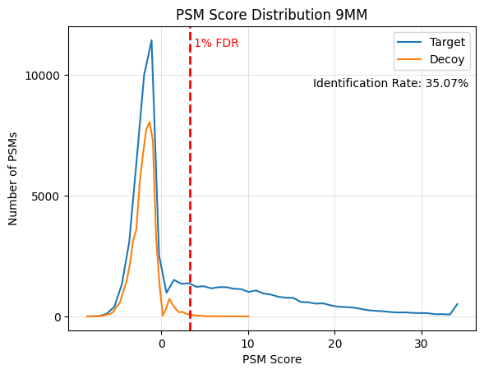


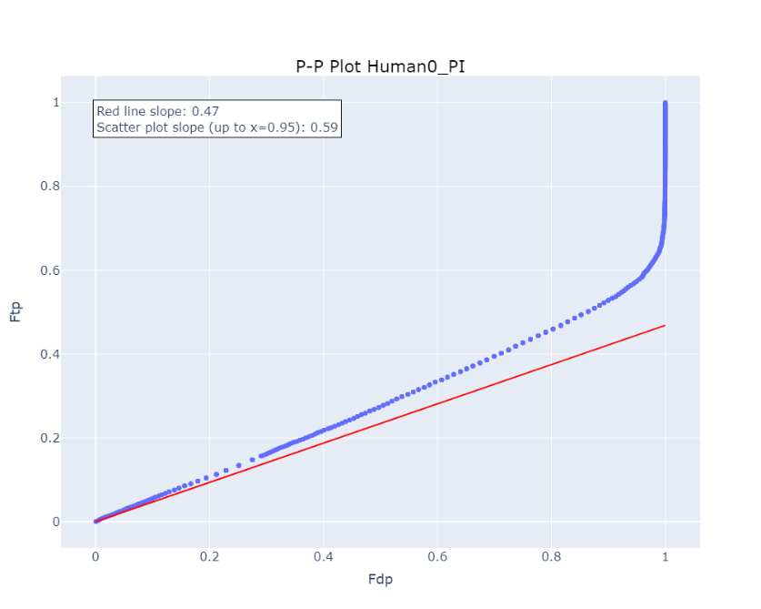


Data collection
Data processing
Controlling the TDA assumptions
X!Tandem
5 fasta files
10 .raw files
1 fasta file
2 .raw files
Notes:
Then, how did I actually do this?
I collected the mass spectrometry data and protein databases from public repositories and made sure everything was in the right format to perform the X!Tandem and Sage searches. I then analysed the results and visualized them using score distribution histograms and P-P plots which can be used to assess the fulfilment of the TDA assumptions.

Slide 10
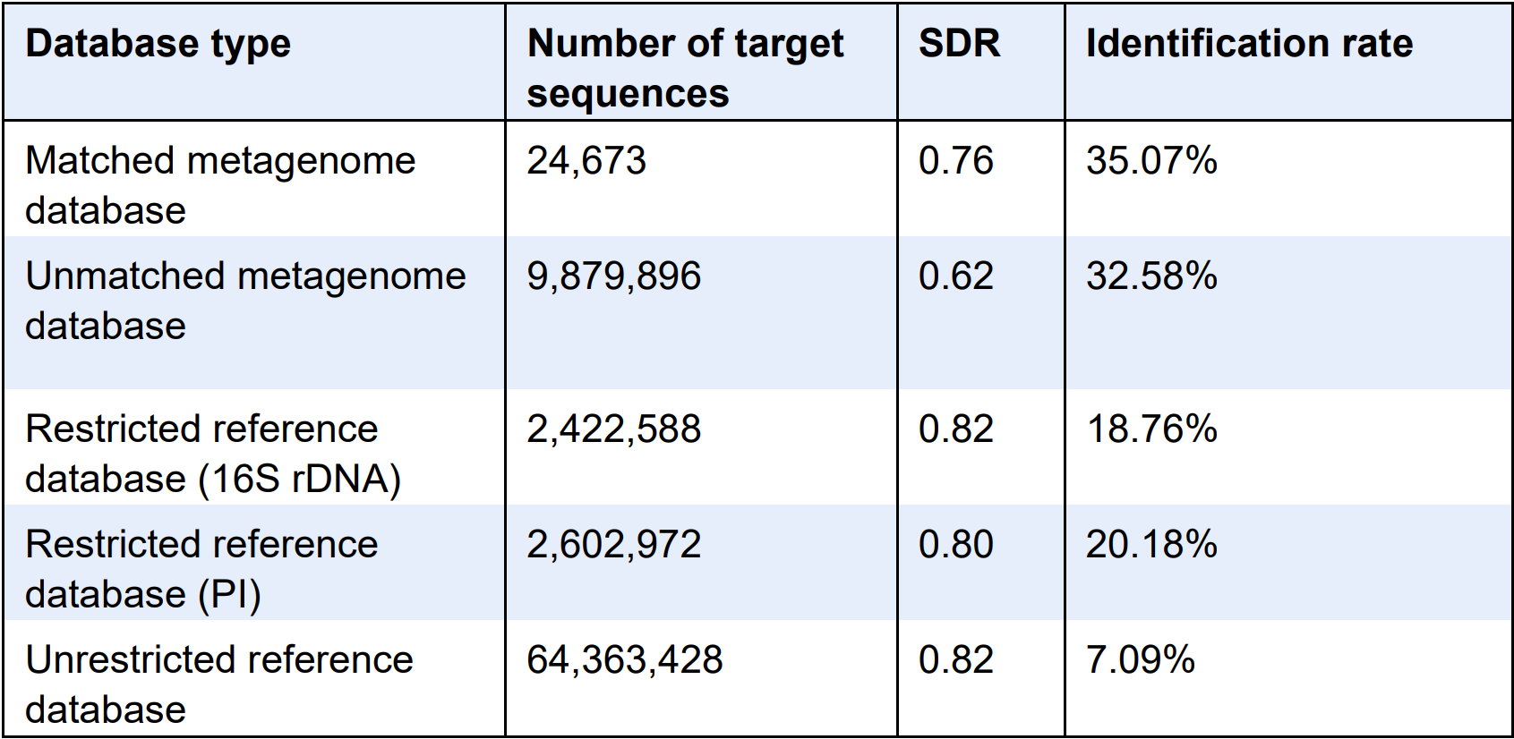
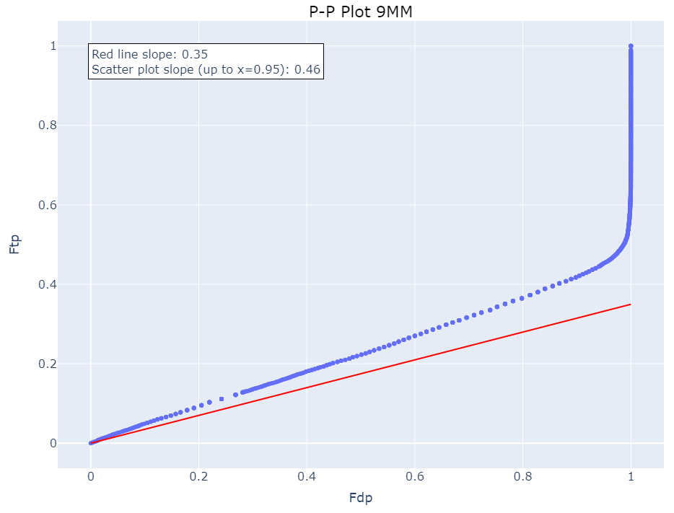
Results: database construction
Matched metagenome
Notes:
With that we come to the actual results, all of which presented here were generated with X!Tandem, and we’ll first take a look at the database construction methods.
Here we see a score distribution histogram and P-P plot of the matched metagenome database alongside a table of results for all database types. The identification rates are the highest for the metagenome databases and diminish towards to the unrestricted reference database. We see similar score distributions right here, which was the case for all databases, indicating fulfilment of the first assumption. To control fulfilment of the second TDA assumption we have introduced the Slope Deviation Ratio (SDR) which is the quotient of the pi-zero line in red (expected fraction of incorrect targets) over the observed fraction of incorrect targets (in blue). If this value is 1, we obtain a reliable FDR estimation, if it is smaller than 1, we underestimate the FDR and if it is bigger we overestimate the FDR. We observe that the SDR is lower in the metagenome databases and grows larger in the reference databases, but it never reaches a value close to 1. So, the second target-decoy assumption is never fulfilled.

Slide 11
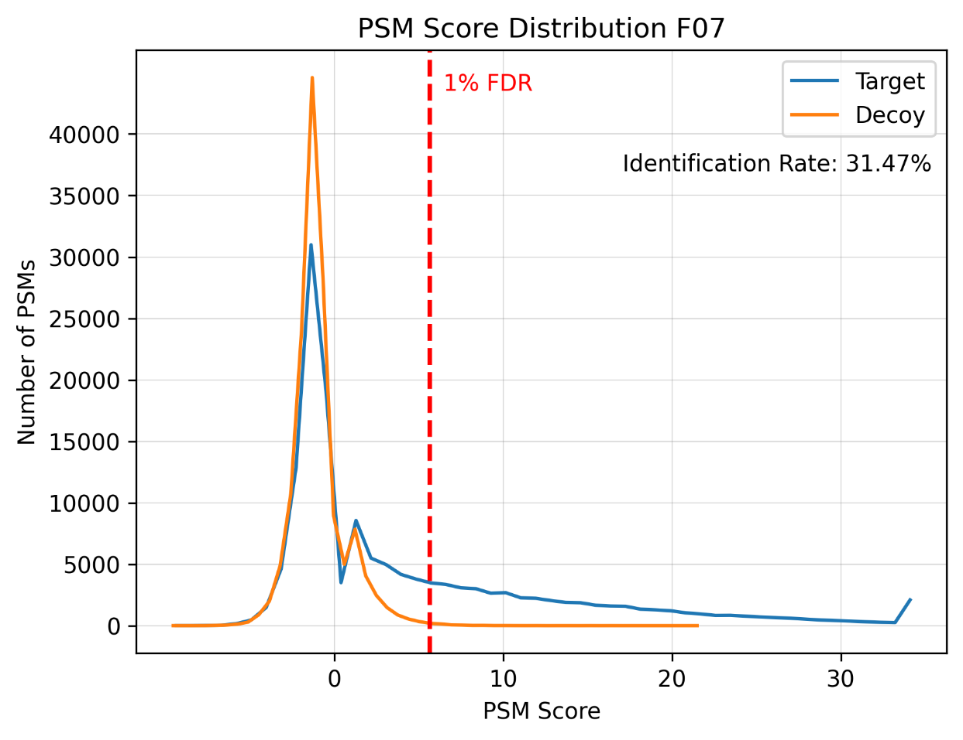
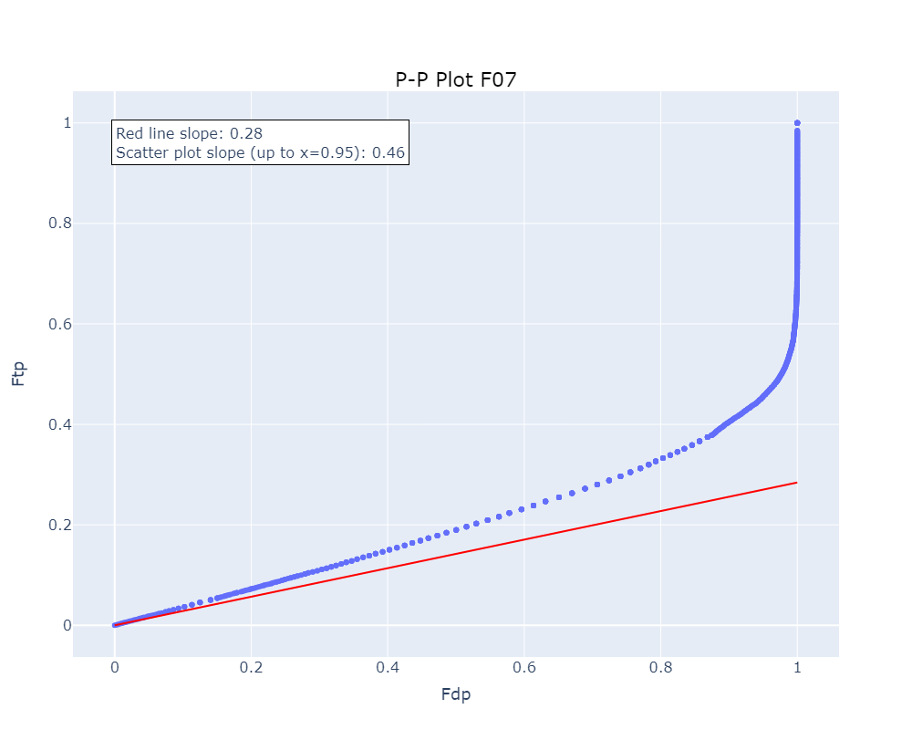
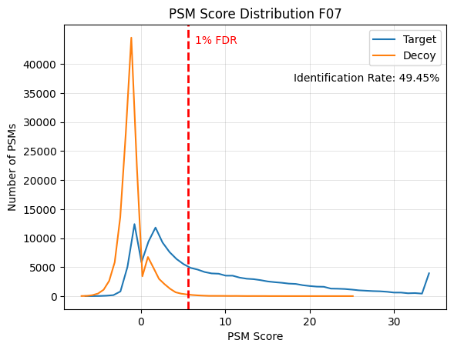
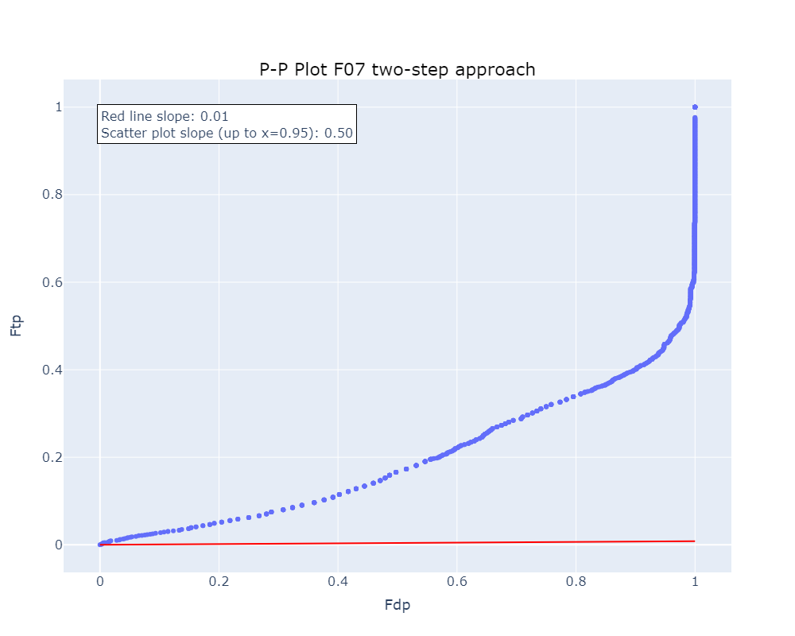
Database reduction: normal vs two-step search
Unmatched metagenome
Unmatched metagenome
SDR = 0.61
Normal search
SDR = 0.02
Two-step search
Notes:
That brings us to the database reduction methods which aim to ameliorate the identification rate. Here we see the results of one sample where I compare the results of a normal search (top) with the results of a two-step search (bottom). We can clearly see that the two-step approach does what it aims to do and clearly increases the identification rate. At the same time it also clearly instigates violation of both the first and the second TDA assumption, shown in the dissimilar score distributions and the SDR dropping from 0.61 to 0.02, respectively.

Slide 12
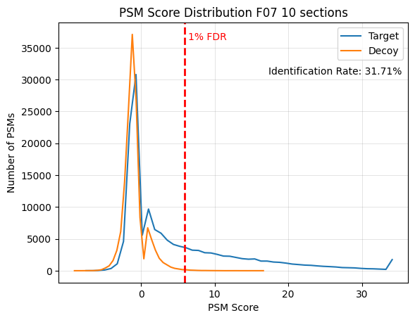
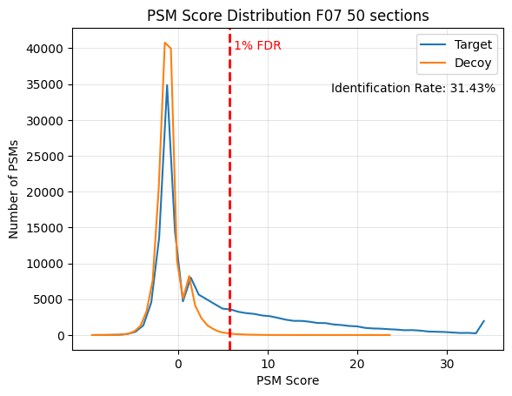

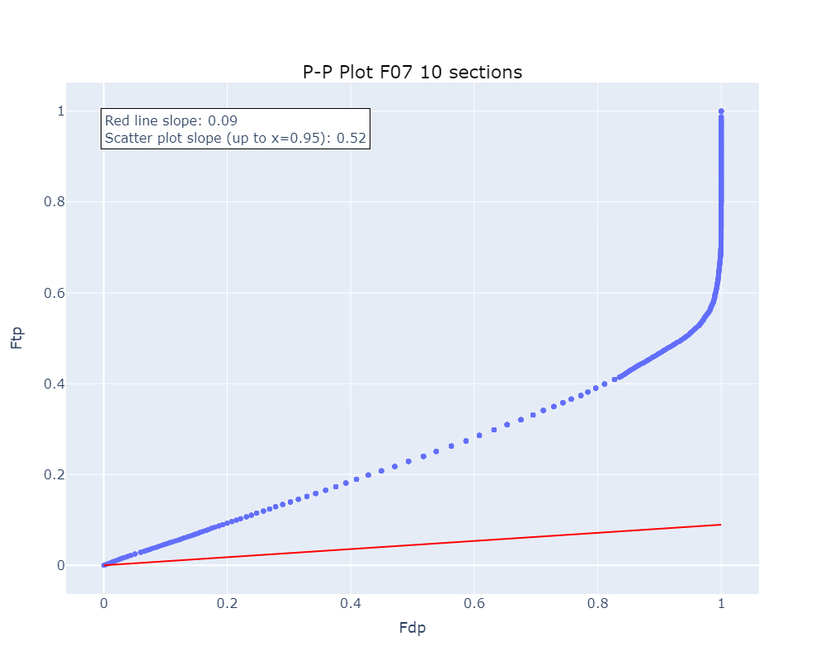
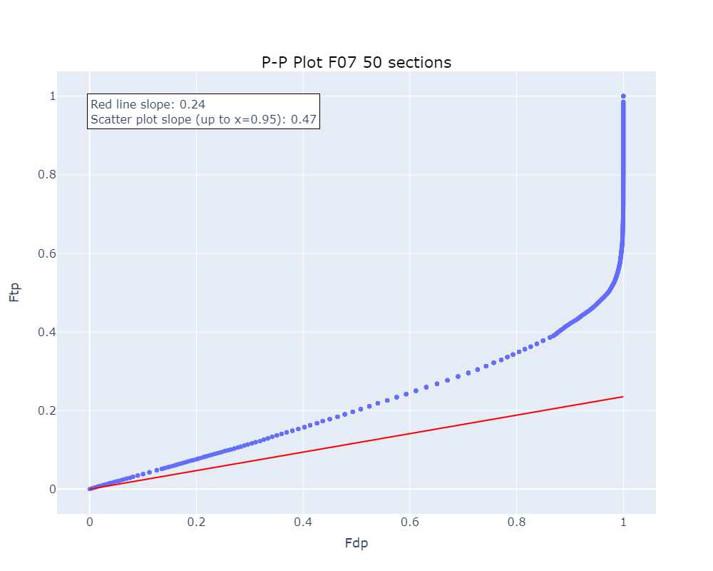
Database reduction: database sectioning
10 sections
50 sections
Normal search
SDR = 0.17
SDR = 0.51
SDR = 0.61
Notes:
We then arrive at the results of the database sectioning method where we clearly see that as the number of sections rises we obtain better and better adherence to the TDA assumptions. The score distributions of the targets and decoys are always very similar and the SDR grows from 0.17 to 0.51. This indicates that the database sectioning method is best applied with a higher number of sections.
Although, here I have to make a note. In my master’s dissertation I wrote that this database sectioning method increases the identification rate, unfortunately this is not the case in these results. When compared with the results from the normal search, the identification rate actually stays the same, and the second TDA assumption is adhered to less with the database sectioning. Indicating no reason to use this method based of these results. Although this may also be attributable to an incorrect implementation of the method. Since there was no program or code provided with the original paper to perform this method I wrote the code myself which could contain an error, although I double checked this and was unable to locate an error.

Slide 13
General conclusion
Unrestricted reference database adheres most strictly to the TDA assumptions
Database reduction methods induce violation of the TDA assumptions
Database sectioning is cumbersome and not recommendable
A standard framework to examine the validity of the TDA assumptions could greatly benefit the field
Notes:
With that I want to come to the general conclusion which is fourfold. First, from the assessment of the database construction methods we obtained the most adherence to the TDA assumptions from the unrestricted reference database. The database with the lowest identification rate at least seems to be able to most accurately estimate the FDR.
Second, while database reduction methods (at least the two-step search) can increase the identification rate, in doing so they also induce violations of the TDA assumptions. These extra identifications might not be very reliable, causing these methods to be questionable.
Third, the database sectioning method is really cumbersome to perform and does not show any promising results, making this method not recommendable.
Lastly, I am convinced that a standard framework that can be used to examine the validity of the TDA assumptions could greatly benefit the field. In this way, all researchers could quickly examine whether their FDR estimation is reliable or not which could counter a lot of false identifications.

Slide 14
Contribution to the field & societal impact
Microbial community
Applications
Human health
Gut microbiome
Full protein complement
Ocean & soil microbiome
Environmental science & agriculture
Notes:
In this way this could be a contribution to the field by making sure future studies obtain more reliable findings. The different fields in which metaproteomics is present could then better study the functional activities of microbial communities which in turn could benefit human health, environmental science and agriculture which would create the societal impact.

Slide 15



Wout Cattrijsse 2nd Master Biomedical Sciences Compomics wout.cattrijsse@ugent.be www.ugent.be
Universiteit Gent @ugent
@ugent Ghent University
Notes:
With that being said, I want to thank you for your attention and if there are any more questions, I will be glad to answer them.

Slide 16
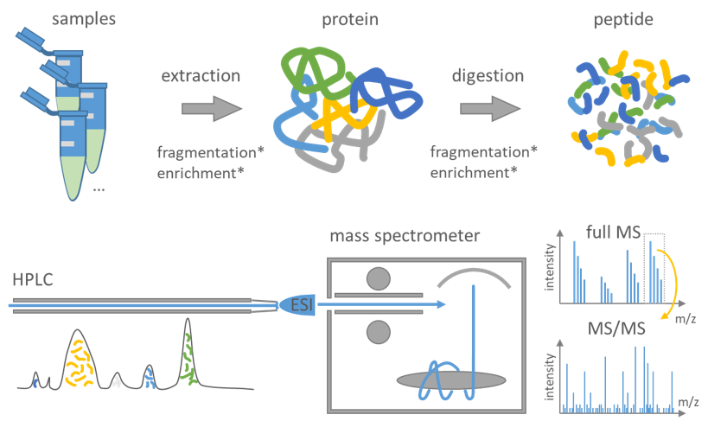
Basic mass spectrometry workflow
Comparison with in silico generated spectra
+
Peptide identification and protein inference
Figure adapted from: https://csbiology.github.io/BIO-BTE-06-L-7/NB02a_Mass_spectrometry_based_proteomics.html#NB02a-Mass-Spectrometry-Based-Proteomics

Slide 17
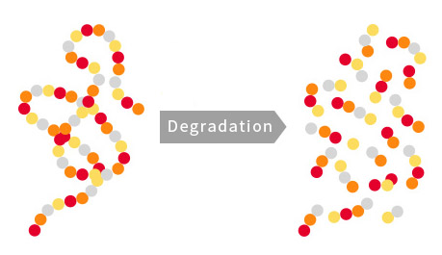
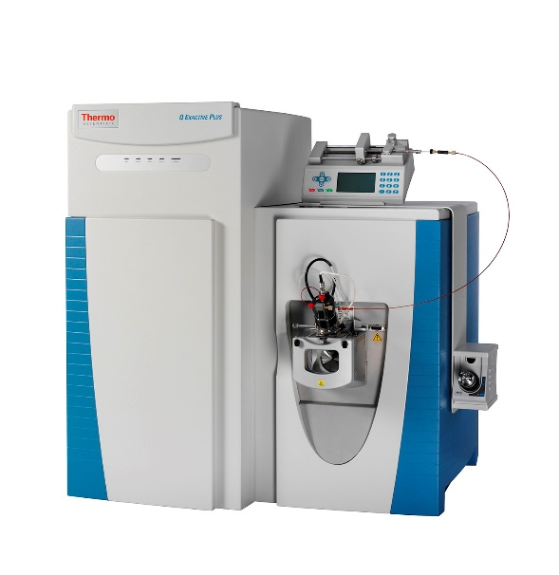
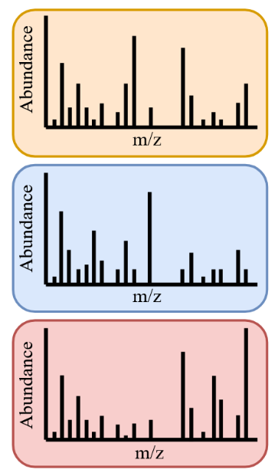



Mass spectrometry workflow
Sample
Protein
Peptide
LC-MS/MS
Experimental fragmentation spectra
Peptide identification +
protein inference
Search engine
In silico digested peptides
Theoretical fragmentation spectra
Protein database

Slide 18
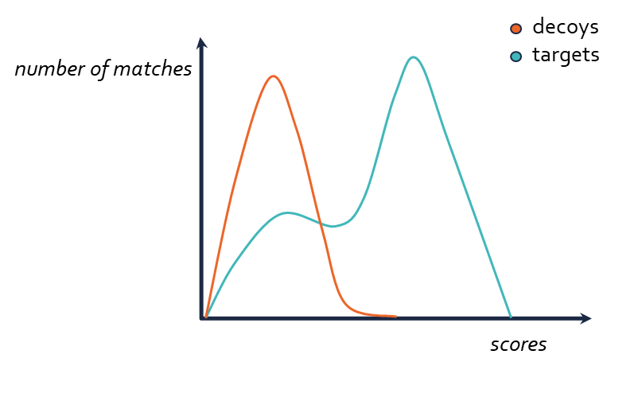
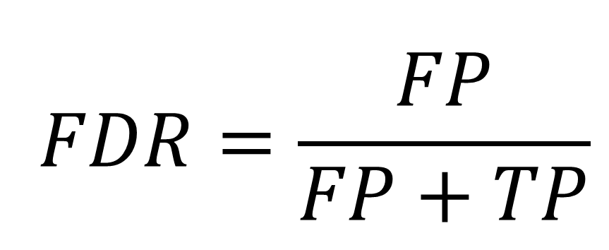
The target-decoy approach (TDA) is the most commonly used method for estimating the FDR
(target) PEPTIDEK vs. (decoy) EDITPEPK
$$FDR=\frac{FP}{FP+TP}$$

Slide 19
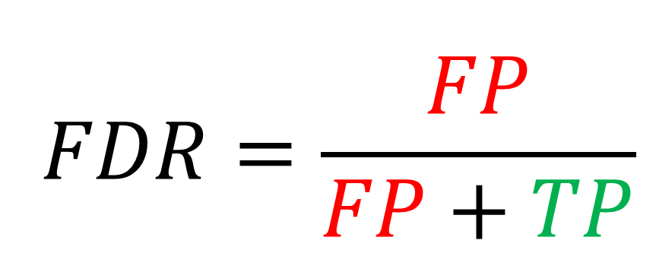
The target-decoy approach (TDA) is the most commonly used method for estimating the FDR
(target) PEPTIDEK vs. (decoy) EDITPEPK
$$FDR=\frac{FP}{FP+TP}$$

Slide 20
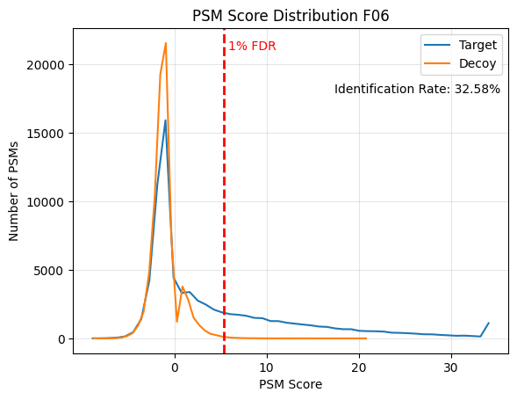

Database construction: metagenome databases
Matched metagenome
Unmatched metagenome

Slide 21
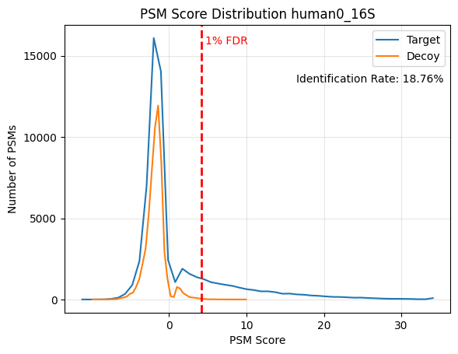
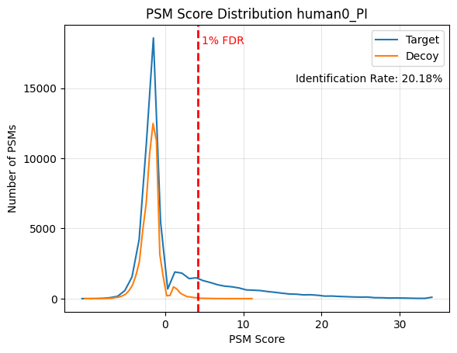
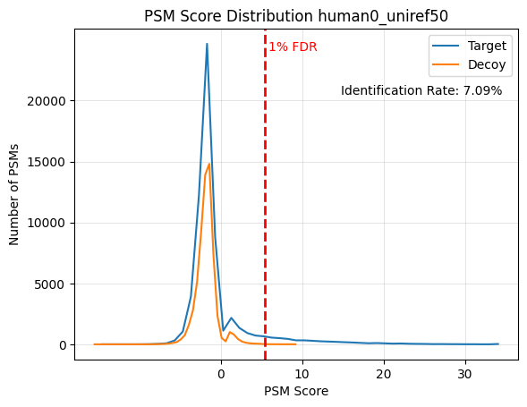
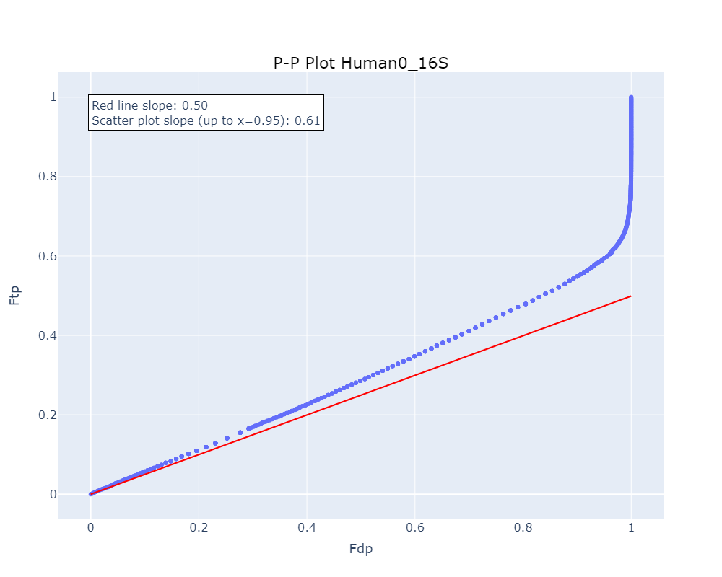
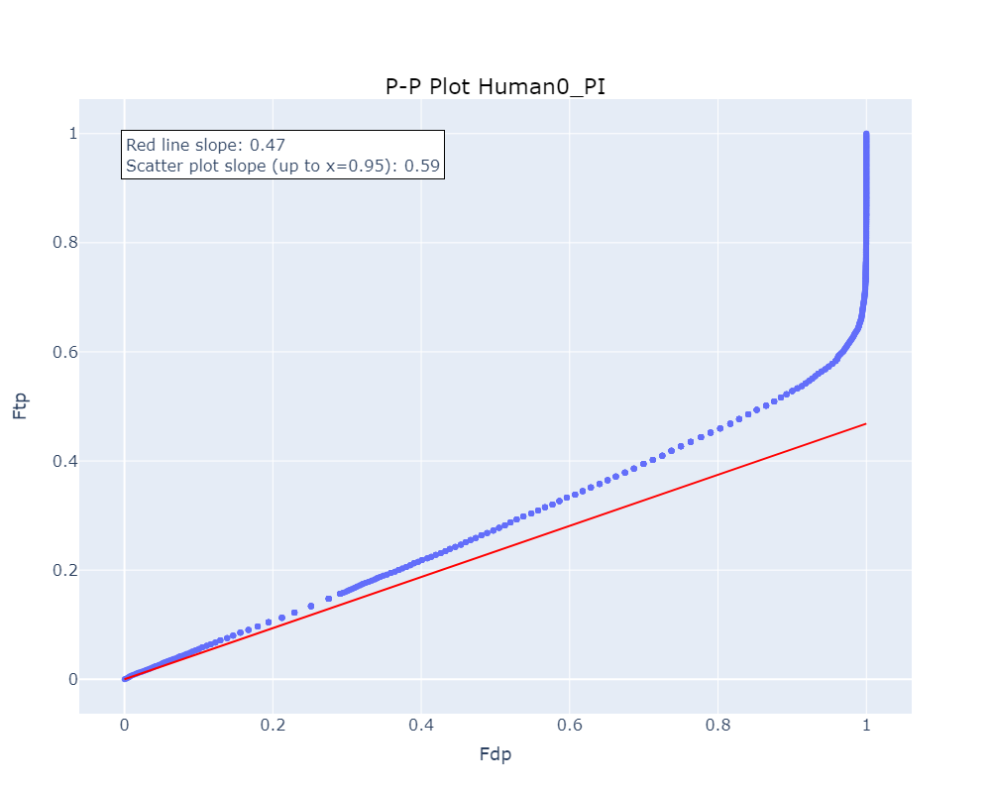
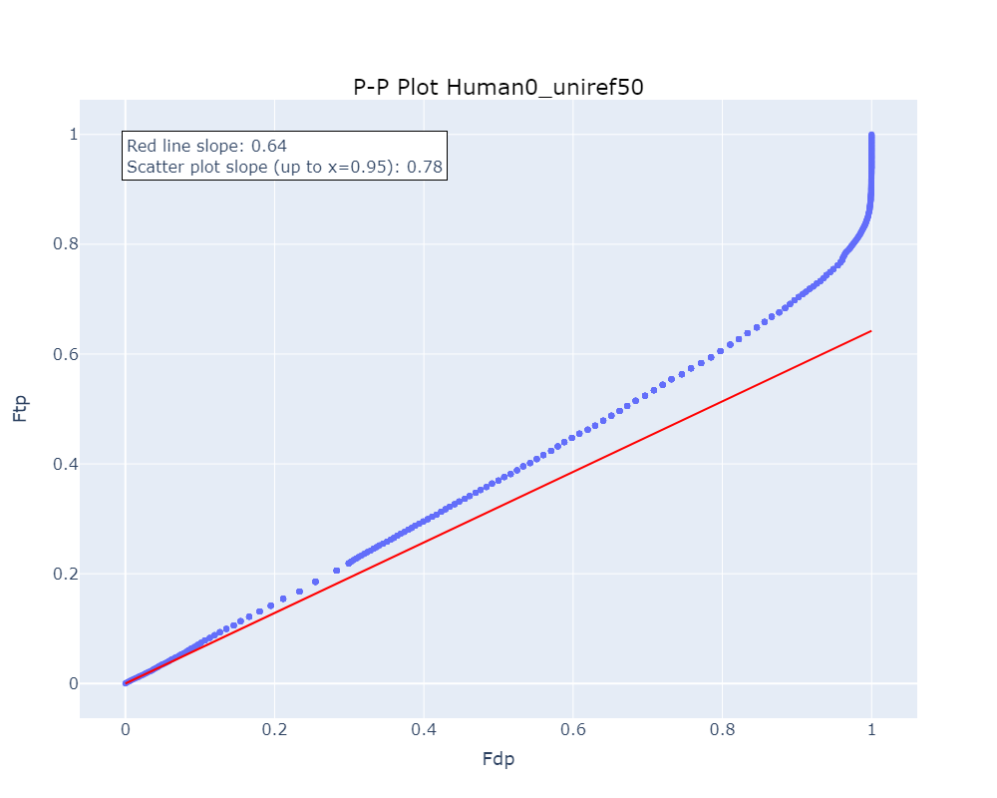
Database construction: reference databases
Restricted reference 16S
Restricted reference PI
Unrestricted reference

Slide 22
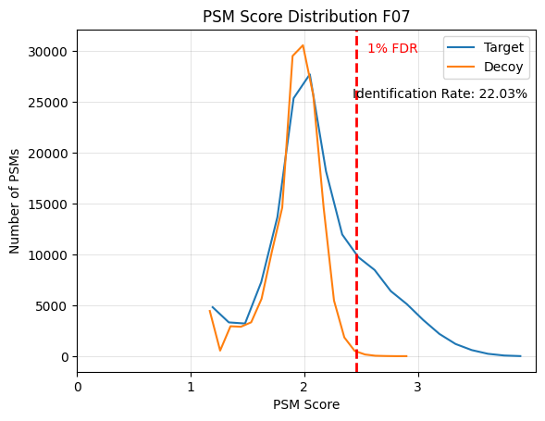
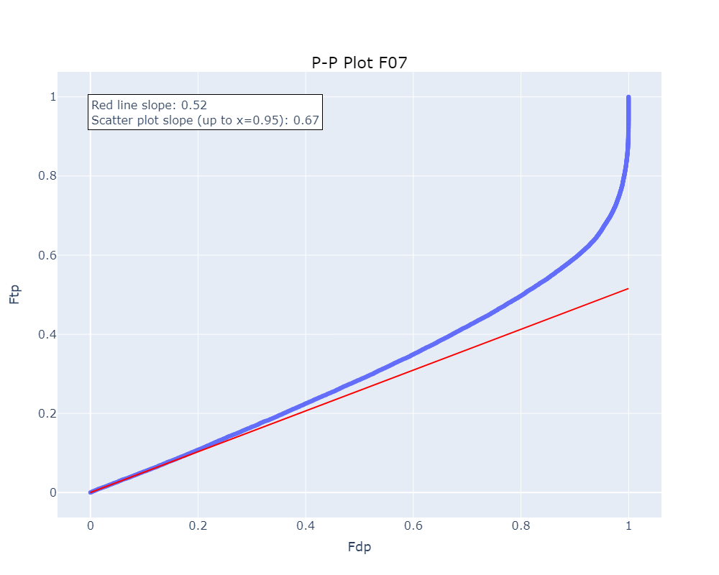
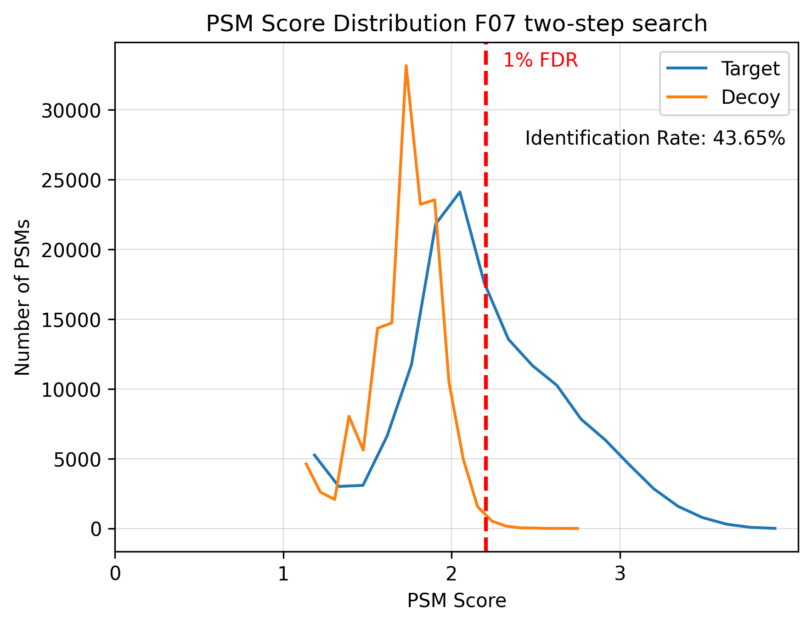
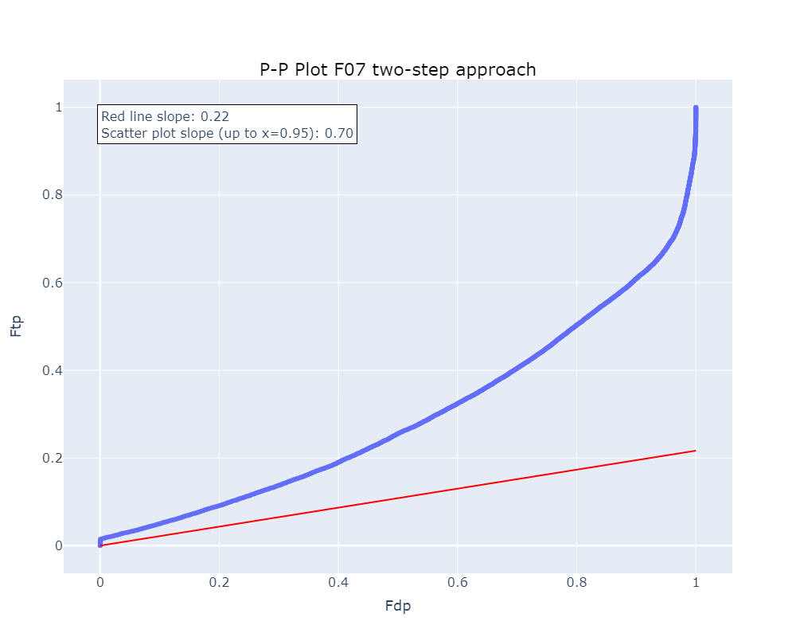
Notes:
Sage normal search vs two-step

Slide 23
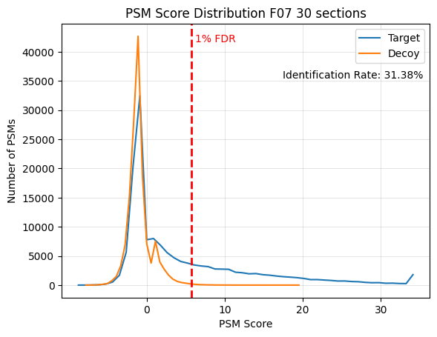
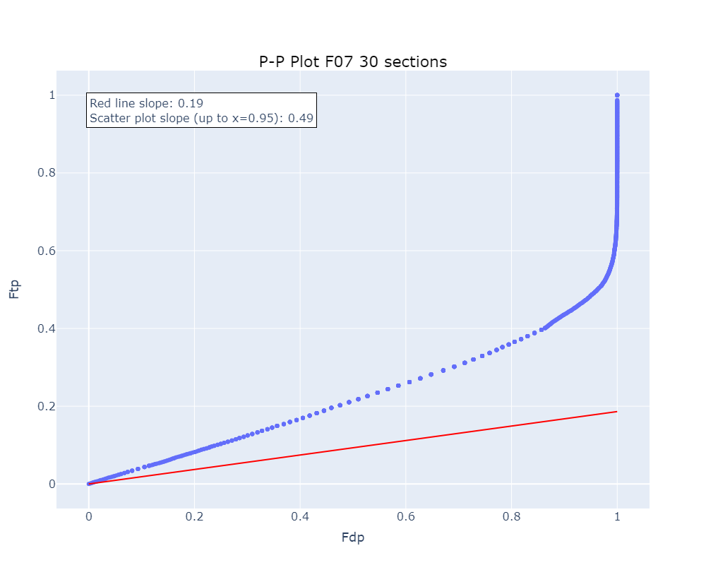
Database reduction: database sectioning
10 sections
30 sections
50 sections

